Slide 2
Azure Search
Liam Cavanagh (@liamca)
Principal Program Manager

Slide 3
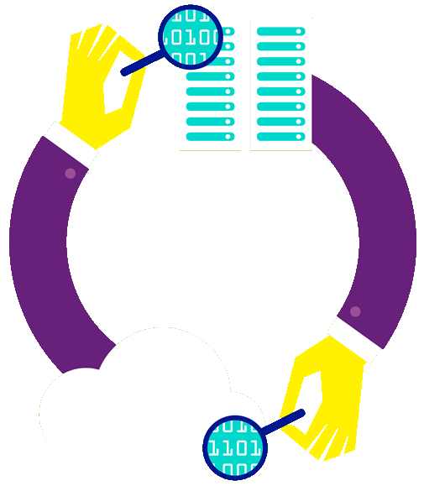
What is Azure Search?
A search-as-a-service solution allowing developers to incorporate great search experiences into applications without managing infrastructure or needing to become search experts.
“Simplify the Search Experience”

Slide 4
Why?
Developers look for PaaS services in Azure to achieve better results faster in their apps
Search is key to many categories of applications
Web search engines have set the bar high for search
Instant results, auto-complete, hit highlighting, great ranking, linguistics
Search is hard and rarely a core expertise area
Infrastructure standpoint: availability, durability, scale, operations
Functionality standpoint: ranking, language support, geo-spatial

Slide 5
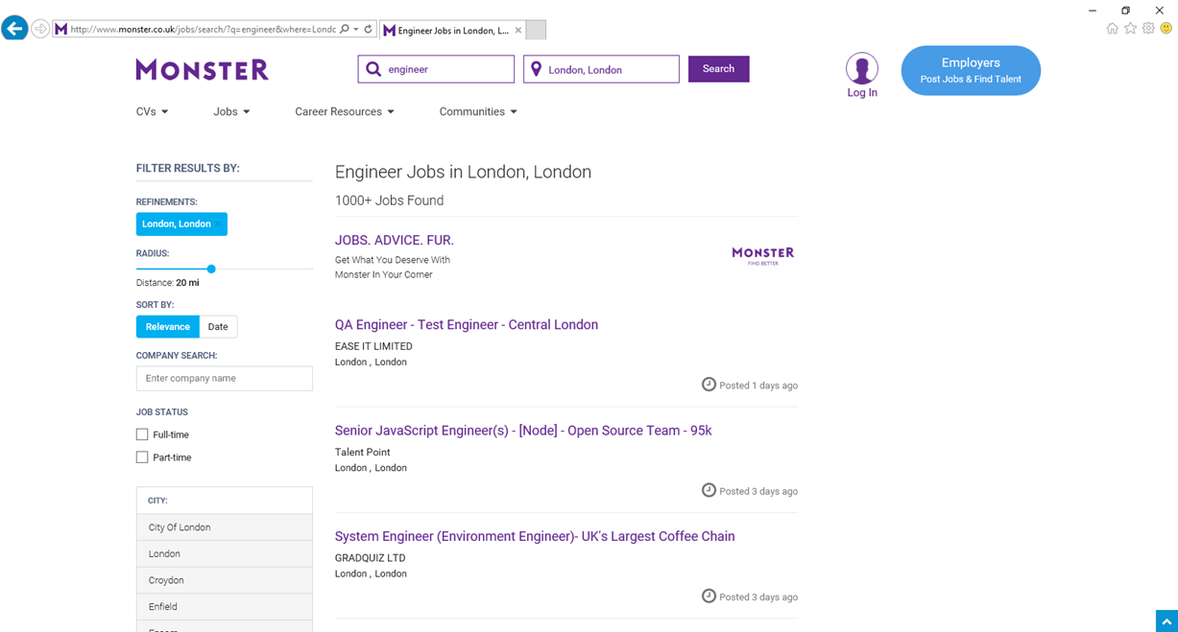
Sorting
Ranking
Facets

Slide 6
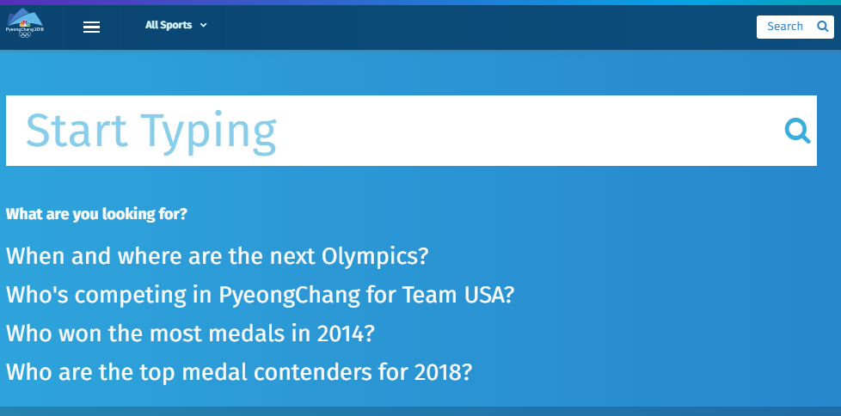
Type Ahead and Search Suggestions

Slide 7
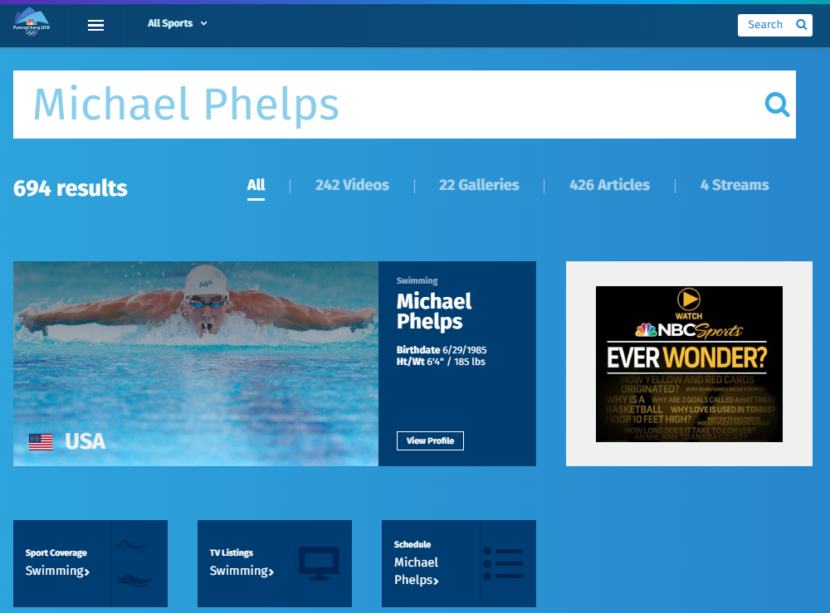
Facets
Tuning
Recommendations

Slide 8
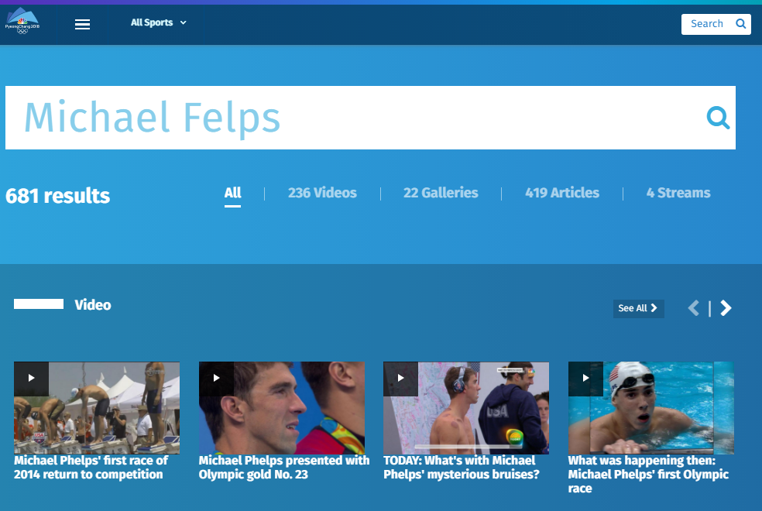
Spelling Mistakes

Slide 9
Typical Workflow
Provision service
Create index
Index data
Search

Slide 10
“Search service”
Scope for capacity
Bound to a region
Has keys, indexes, indexers, data sources
Provisioning
Azure Portal
Azure resource management API
Elastic scale
Capacity can be changed dynamically
Replicas ~ more QPS, HA
Partitions ~ more documents, write throughput
Provision service
Create index
Index data
Search

Slide 11
Demo
Liam Cavanagh

Slide 12
“Index”
Container for data, think “table”
Has schema, CORS options, search options
Create in portal or during app initialization
Typical schema
Fields definition: name, type, key
Search specifics
Field attributes – searchable, facetable, etc.
Linguistics and analysis
Suggesters for auto-complete
Scoring profiles for ranking tuning
Provision service
Create index
Index data
Search

Slide 13
Linguistics
Linguistics are key in search
Support for 56 languages
Word breaking, stop words, inflections
Lucene analyzers
Well-known analyzer stack
Stemming
Microsoft analyzers
Same NLP stack used by parts of Office, Bing
Deep understanding of languages
Lemmatization in many languages

Slide 14
Push - using indexing API
POST to /indexes/<name>/docs/index
Up to 1000 actions per batch
Actions can be upload, merge, delete, etc.
Pull - using indexers
Azure SQL DB, DocumentDB, Blob and Tables
Change detection, deletion markers
Point it at the data source, define policy, done
Provision service
Create index
Index data
Search

Slide 15
Demo
Liam Cavanagh

Slide 16
Search + typical data operations
Simple search options, + - * () “”
Filter, sort, project, page over results
Spelling mistakes, phonetic and RegEx
Options work with search and suggest
Search from client or server
Use query keys when searching from clients
CORS allows direct calls from browsers
Render from search results
Include necessary non-searchable data
E.g. URLs for pictures, keys to main content
Provision service
Create index
Index data
Search

Slide 17
Custom relevance
Scoring profiles
Field weights
Scoring functions
magnitude, freshness, distance, tags
3 main patterns
Known data directly available in the index
Personalization using tag boosting
Analytics, compute externally and push to the index

Slide 18
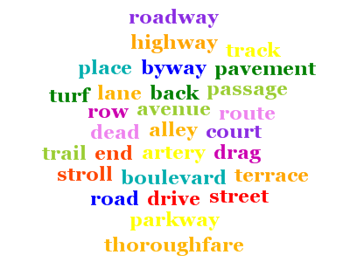
Synonyms (Preview)
Associate equivalent terms that implicitly expand the scope of a query, without user having to actually provide terms. For example:
"dog" can be associated with “canine” & “puppy”
Synonyms are currently in preview, exclusive to the Service REST API (api-version=2015-20-28-preview)
Word mappings is defined in a “synonym map” and is linked to one or more Index fields using synonymMaps in the field definition
Synonyms can be updated as needed
Ties in well with Search Traffic Analytics (Searches with 0 Results)

Slide 19
Demo
Liam Cavanagh

Slide 20
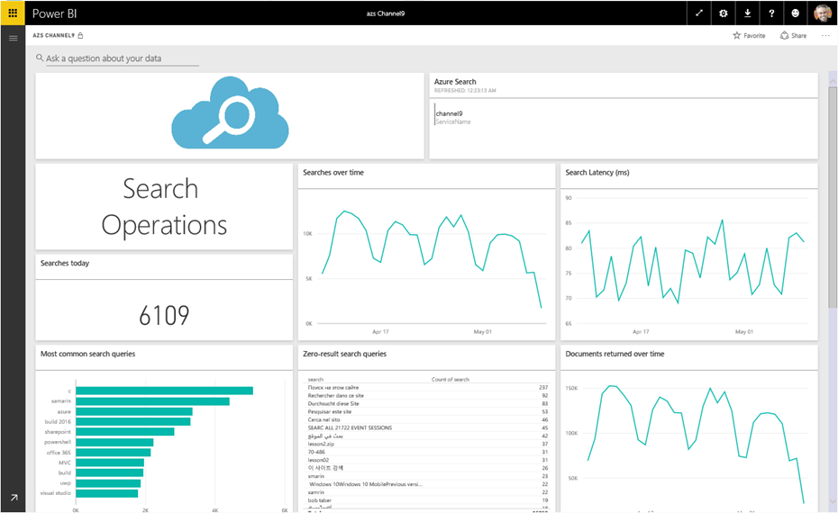
Cater to the Long Tail Search
“70% of searches are unexpected”¹
Notes:
https://www.internetretailer.com/commentary/2016/03/11/5-strategies-beat-amazon

Slide 21
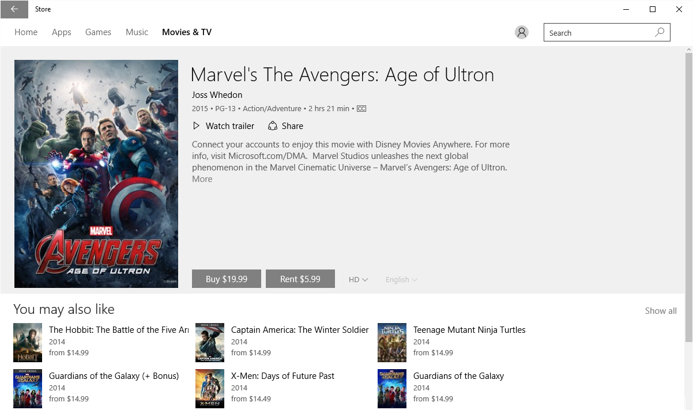
Recommendations

